Slide 1
Azure Community Conference 2021

Slide 2


Title Sponsor
Gold Sponsor
Community Partner

Slide 3

VAHID FARAHMANDIAN
CTO, Aspian

Slide 4
Connect to Elasticsearch using Azure DevOps Pipeline Extensions
Vahid Farahmandian

Slide 5
Contents
Who am I?
What are Extensions?
Azure DevOps Extensions
Connect to Elasticsearch using Postman
Azure DevOps + PowerShell + Elasticsearch

Slide 6
Who am I?
Currently:
CTO at Aspian Company
Instructor at FAD Institute
Formerly:
Principal Software Consultant at Ports & Maritime Org of Iran
SQL Server Consultant at The Railways Org of Iran
Instructor at MFT & Cybertech Institutes

Slide 7
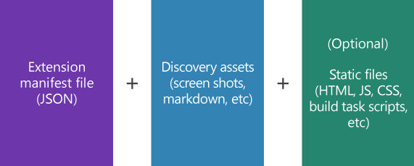
What are Extensions
Are add-ons you can use to customize and extend your DevOps experience with Azure DevOps.
Use Azure DevOps’s RESTful API Library to easily interact with Azure DevOps and applications/services.

Slide 8
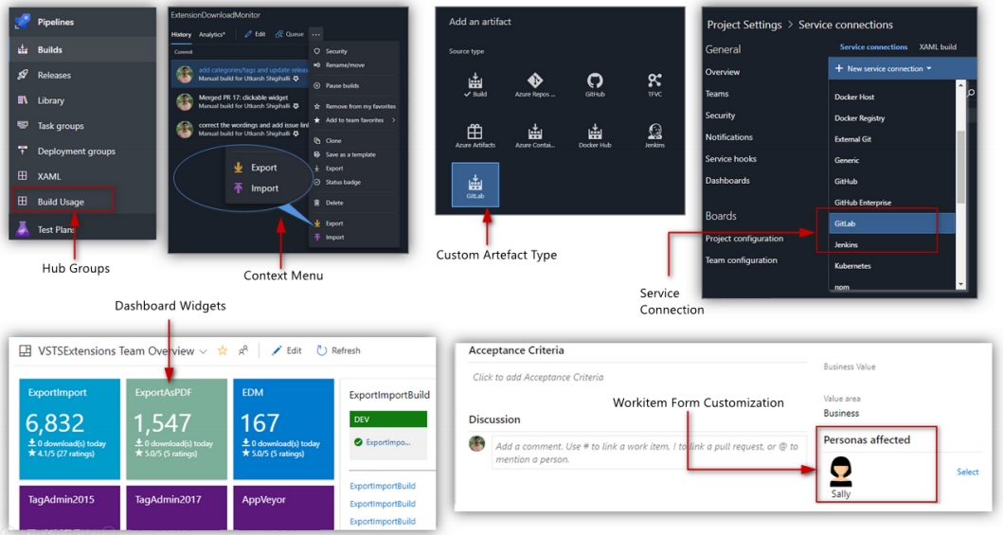
Azure DevOps Extensions
Pipeline task extensions: Can be consumed in pipelines and are available as tasks for the Azure DevOps agent.
UI extensions: Enhance the usability of the Azure DevOps Server.

Slide 9
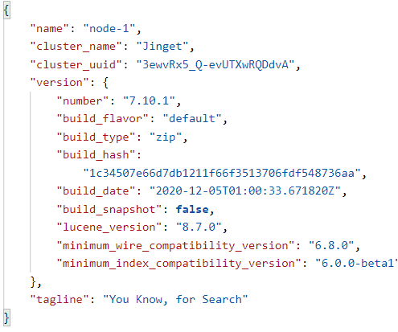
Connect to Elasticsearch using Postman
curl --location --request GET ‘<url>’ \ --header 'Authorization: Basic <token>'
url: Url to Elasticsearch, for example: http://192.168.1.20:9200
token: Base64 encoded elasticUsername:elasticPassword

Slide 10
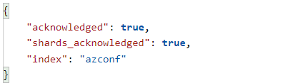
Connect to Elasticsearch using Postman
Check if index exists:
curl --location --request GET ‘<url>/azconf’ \ --header 'Authorization: Basic <token>'
Create index if index does not exist:
curl --location --request PUT ‘<url>/azconf’ \ --header 'Authorization: Basic <token>'

Slide 11
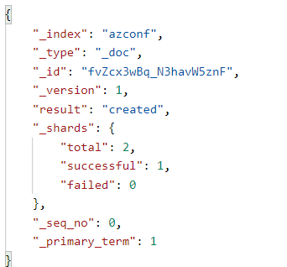
Connect to Elasticsearch using Postman
Create document:
curl --location --request POST ‘<url>/azconf/_doc' \
--header 'Content-Type: application/json' \
--header 'Authorization: Basic <token>' \
--data-raw '{
"id":"1","name":"vahid"
}'

Slide 12
Azure DevOps + PowerShell + Elasticsearch
$indexName = 'azconf'
$url = $url+'/'+$indexName
$headers = @{'Authorization' = 'Basic <token>'}
try{
Invoke-RestMethod -Method Get -Headers $headers -Uri $url
}
catch{
if($_.Exception.Response.StatusCode.value__ -ge 300){
Invoke-RestMethod -Method Put -Headers $headers -Uri $url
}
}
$url = $url+'/_doc'
$data = @{
id = 1
name = "vahid"
}
$jsonData = ConvertTo-Json $data -Compress
Invoke-RestMethod -Method Post -Headers $headers -Uri $url -Body $jsonData
Source codes of this session are available at:
https://GitHub.com/VahidFarahmandian/azconf2021

Slide 13
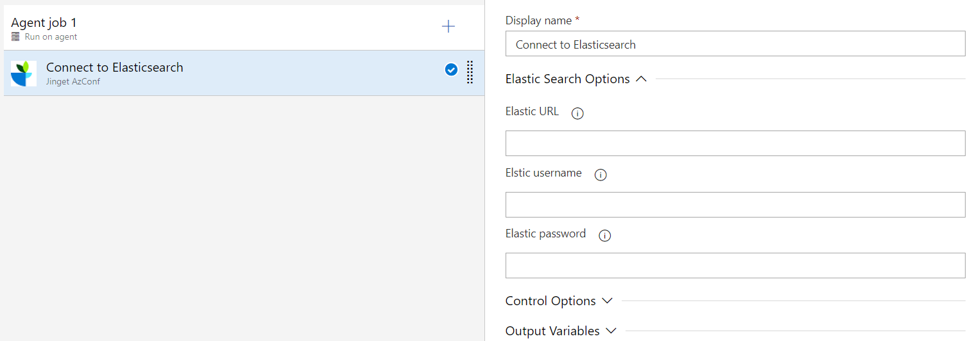
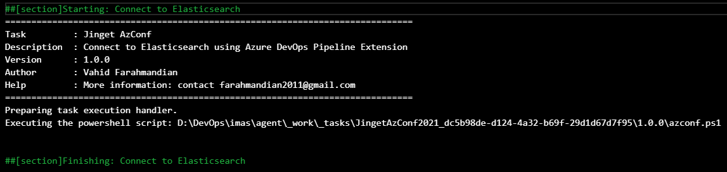
Azure DevOps + PowerShell + Elasticsearch
Create extension using tfx extension create command
Upload and install the extension

Slide 14





Our Partners

Slide 15

Communities

Slide 16
Q & A

Slide 17
Feedback

Slide 18




THANK YOU!
VahidFarahmandian
Vahid Farahmandian
CTO, Aspian
VFarahmandian
_jinget
VahidFarahmandian

